Slide 1
IP Addressing: Classful Addressing
Training Division

Slide 2
Objectives
Understand IPv4 Addressing
Different Address Notations
Address Space
Various Classes in Classful Addressing
Describe a Network Address
Address Mask
Special addresses and private addresses
Unicast, Multicast, and Broadcast Addresses

Slide 3
IP Addressing
Each device needs to be uniquely identified on the Internet at the Network (IP) layer
The identifier in the IP layer of TCP/IP that identifies each device is called the Internet Address or IP Address
32-bit binary address
Two devices never have the same address
A single device can have more than one IP Address

Slide 4
Address Space
Total number of addresses used by the protocol
If N bits are used then the address space is 2^{N}
IPv4 uses 32 bits so the address space is 2³² or 4,294,967,296 (more than four billion)‏

Slide 5
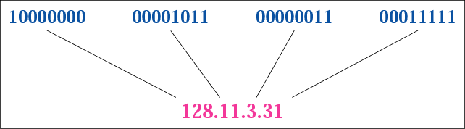
Notations
Binary Notation
  01110101 10010101 00011101 11101010
Dotted-Decimal Notation
Hexadecimal Notation
  Each hexadecimal digit is equivalent to four bits
  11000001 10000011 00011011 11111111
  C1 83 1B FF

Slide 6
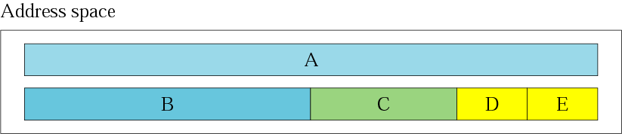
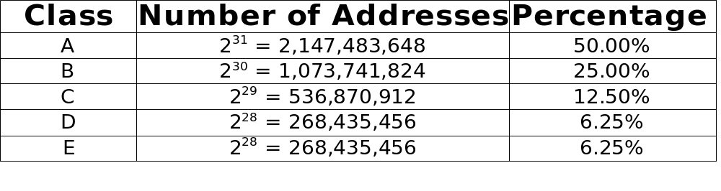
Classful Addressing
Address Space is divided into five classes

Slide 7
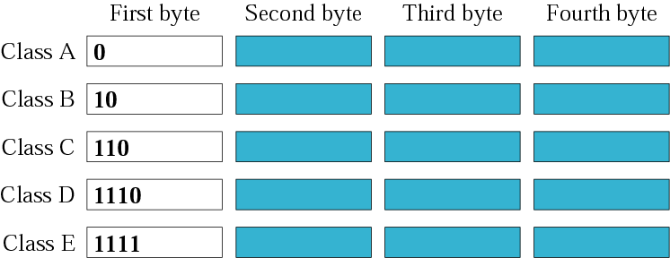
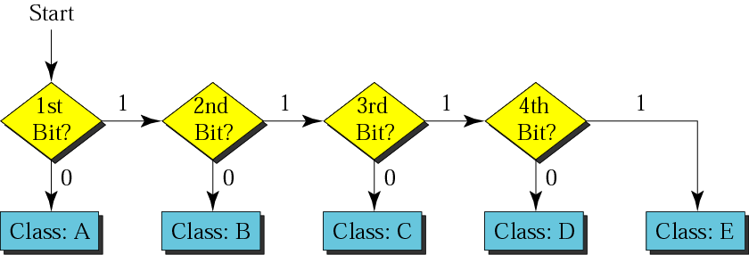
Recognising Classes
Binary Notation

Slide 8

Recognising Classes
Dotted-Decimal Notation

Slide 9
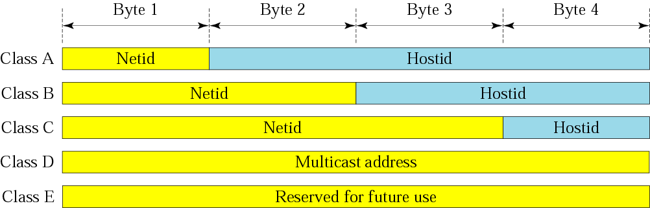
Net Id and Host Id
Classful addressing divides IP addresses into netId and hostId.

Slide 10
Class A
128 blocks
1 block (10.0.0.0 - 10.255.255.255) is reserved for private addresses
Each block has 16,777,216 addresses
(256 * 256 *256)‏
First block - 0.0.0.0 to 0.255.255.255
Last block - 127.0.0.0 to 127.255.255.255
Millions of class A addresses are wasted
First and last blocks are reserved for special purposes

Slide 11
Class B
16,384 blocks (64 * 256)‏
16 blocks (172.16.0.0 - 172.32.255.255) reserved for private addresses
Each block has 65,536 addresses (256 * 256)‏
First block - 128.0.0.0 to 128.0.255.255
Last block - 191.255.0.0 to 191.255.255.255
Many class B addresses are wasted

Slide 12
Class C
2,097,152 blocks ( 32 * 256 * 256 )‏
256 blocks(192.168.0.0 - 192.168.255.255) reserved for private addresses
Each block has 256 addresses
First block - 192.0.0.0 to 192.0.0.255
Last block - 223.255.255.0 to 223.255.255.255
Number of addresses to small for most organisations

Slide 13
Class D
Just one block
Designed for multicasting
Each address defines one group of hosts

Slide 14
Class E
Just one block
Designed for use as a reserved address

Slide 15
Network Address
First address in a block
Defines the network to the rest of the Internet
Given the network address; the class, block and range of addresses can be determined

Slide 16
Mask
Allows the network address to be extracted from an IP address
32-bit binary number that gives the network address when bitwise ANDed with an address

Slide 17
Default Masks
Class A => 255.0.0.0
Class B => 255.255.0.0
Class C => 255.255.255.0
The network address is the beginning address of each block. It can be found by applying the default mask to any of the addresses in the block. It retains the netId of the block and sets the hostId to zero.

Slide 18
Special Addresses
Some parts of the address space are used for special addresses
Special Address
NetId
HostId
Source or Destination
Network address
Specific
All 0s
None
Direct broadcast address
Specific
All 1s
Destination
Limited broadcast address
All 1s
All 1s
Destination
This host on this network
All 0s
All 0s
Source
Specific host on this network
All 0s
Specific
Destination
Loopback address
127
Any
Destination

Slide 19
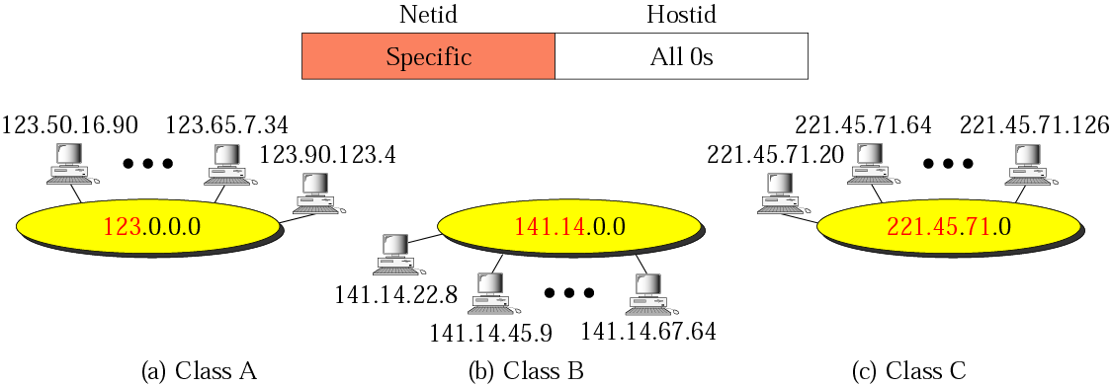
Network Address
First address in a block defines the network address.

Slide 20
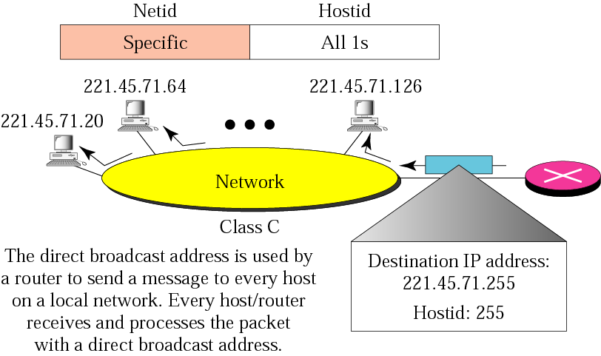
Direct Broadcast Address
Used by routers to send a packet to all hosts in a specific network.

Slide 21
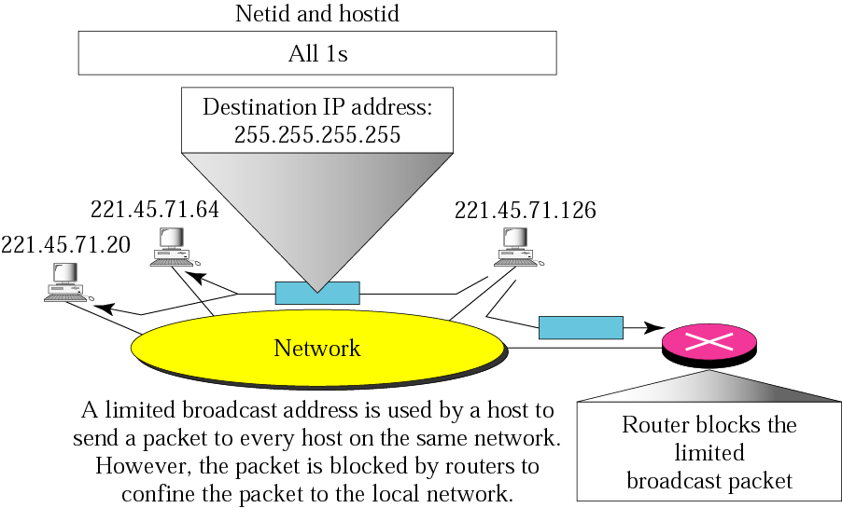
Limited Broadcast Address
Broadcast address for the current network.
Sent to all hosts on the current network but blocked by routers to external networks.

Slide 22
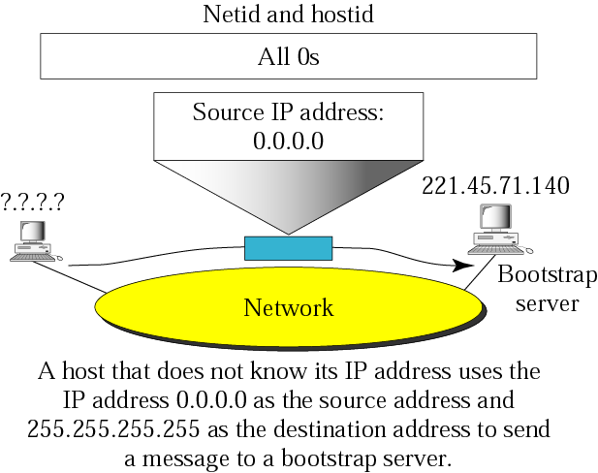
This Host on This Network
Used by a host at bootstrap time when it does not know its IP address.

Slide 23
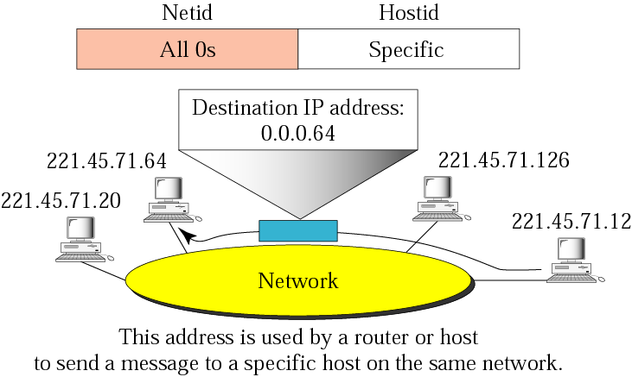
Specific Host on This Network
Used by a host to send a message to another host on the same network.

Slide 24
Loopback Address
IP address with the first byte 127 is used for the loopback address.
Used to test the software; the packet never leaves the machine; it simply returns to the protocol software

Slide 25
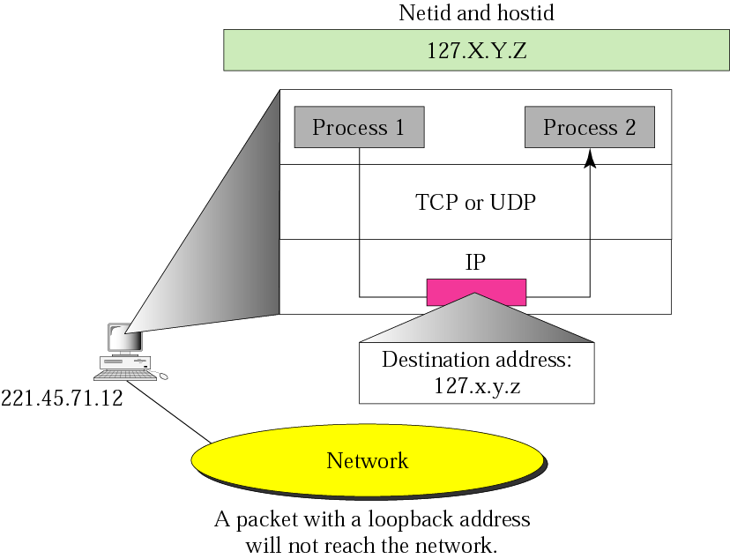
Example of loop back address

Slide 26
Private Address
A number of blocks in each class are assigned for private use. (NAT)‏
Class
NetIds
Blocks
A
10.0.0
1
B
172.16 to 172.31
16
C
192.168.0 to 192.168.255
256

Slide 27
Unicast Addresses
one-to-one communication
packet sent from individual source to an individual destination
Classes A, B, or C

Slide 28
Multicast Addresses
one-to-many communication
packet sent from an individual source to a group of destinations
Class D

Slide 29
Broadcast Addresses
one-to-all communication
broadcasting is only allowed at a local level

Slide 30
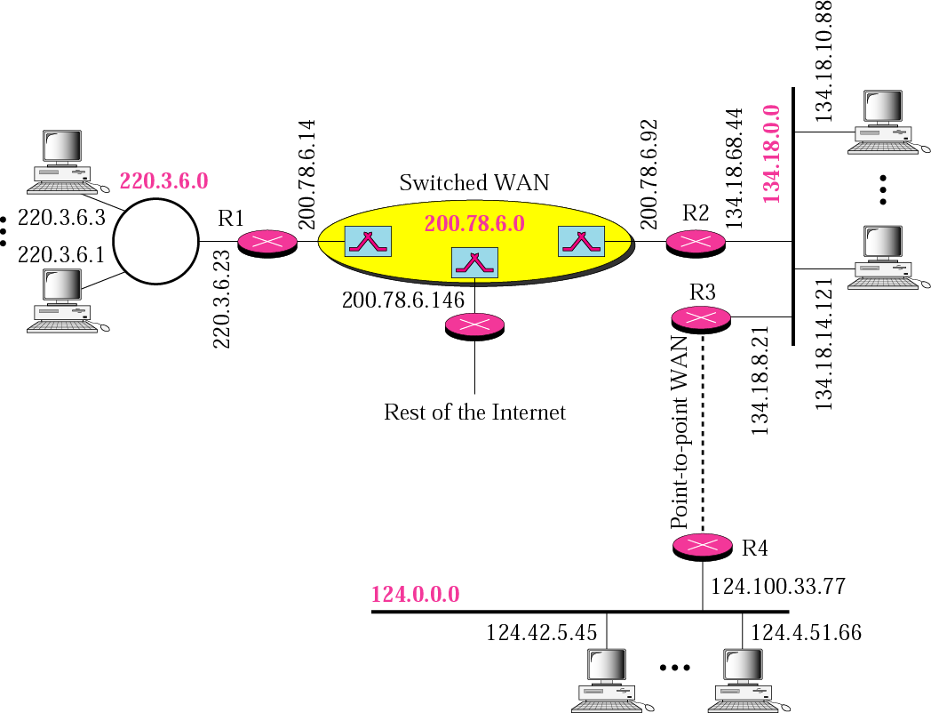
Sample

Slide 31
Thank You

